Slide 1
CS5100: Foundations of Artificial Intelligence First Order Logic
Dr. Rutu Mulkar-Mehta
Lecture 7

Slide 2
Administrative
EC1 (Constraint Satisfaction Problems) is graded and handed back to you
Project 1: Grading is complete. You should have received an email with your score.
Project 2 is out last week. Please start EARLY!
Next Week – Guest Speaker from Voicebox Technologies (Dr. Phil Smith)
In Class Assignment – Today and Next week!

Slide 3
Last Week
First Order Logic
Syntax and Semantics
Quantifiers
Unification
Inference using forward chaining
Inference using backward chaining

Slide 4
Constants, Functions, Predicates
Constant symbols, which represent individuals in the world
Mary
3
Green
Function symbols, which map individuals to individuals
father-of(Mary) = John
color-of(Sky) = Blue
Predicate symbols, which map individuals to truth values
greater(5,3) = true
green(Grass) = true
color(Grass, Green) = true

Slide 5
Variables, Connectives and Quantifiers
Variable symbols
They can hold any value
E.g., x, y, foo
Connectives
Same as in PL: not (¬), and (^), or (v), implies (→), if and only if (⬄)
Quantifiers
Universal (Ax)
Existential (Ex)

Slide 6
Quantifier Scope
Switching the order of universal quantifiers does not change the meaning:
(Ax)(Ay)P(x,y) → (Ay)(Ax) P(x,y)
Similarly, you can switch the order of existential quantifiers:
(Ex)(Ey)P(x,y) → (Ey)(Ex) P(x,y)
Switching the order of universals and existentials does change meaning:
(Ax)(Ey) likes(x,y)
Everyone likes someone
(Ey)(Ax) likes(x,y)
Someone is liked by everyone

Slide 7
Unification
Unification – takes two similar sentences and computes the substitution that makes them look the same
Unify(α,β) = θ if subs(α,θ) = subs(β,θ)
p q θ
Knows(John,x) Knows(John,Jane) {x/Jane}}
Knows(John,x) Knows(y,OJ) {x/OJ,y/John}}
Knows(John,x) Knows(y,Mother(y)) {y/John,x/Mother(John)}}
Knows(John,x) Knows(x,OJ) {fail}

Slide 8
Example knowledge base
The law says that it is a crime for an American to sell weapons to hostile nations. The country Nono, an enemy of America, has some missiles, and all of its missiles were sold to it by Colonel West, who is American.
Prove that Col. West is a criminal

Slide 9
Example knowledge base contd.
... it is a crime for an American to sell weapons to hostile nations:
American(x) ∧ Weapon(y) ∧ Sells(x,y,z) ∧ Hostile(z) ⇒ Criminal(x)
Nono … has some missiles, i.e., ∃x Owns(Nono,x) ∧ Missile(x):
Owns(Nono,M₁) and Missile(M₁)
… all of its missiles were sold to it by Colonel West
Missile(x) ∧ Owns(Nono,x) ⇒ Sells(West,x,Nono)
Missiles are weapons:
Missile(x) ⇒ Weapon(x)
An enemy of America counts as "hostile“:
Enemy(x,America) ⇒ Hostile(x)
West, who is American …
American(West)
The country Nono, an enemy of America …
Enemy(Nono,America)

Slide 10
Today
Knowledge Representation and Reasoning
Ontological Engineering
Taxonomies
Representing Events
In Class Assignment in SWI-Prolog
Notes:
Focus of todays class (and possibly next class too) is more research oriented, and the emphasis is on real world problems

Slide 11
This Class
How to use first order logic to represent the most important aspects of the real world – action, space, time, etc.

Slide 12
Ontological Engineering
Ontology – A formal Conceptualization of the world
We need general and flexible notations to describe complex domains
We need to be able to reuse our ontological representations for new domains
High level concepts exists in most domains
e.g. The concepts of time, space can be reused in the domain of Chemical Reactions or for representing a game of Football
Representing abstract concepts in Logic is known as Ontological Engineering

Slide 13
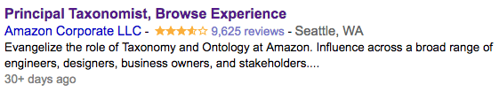

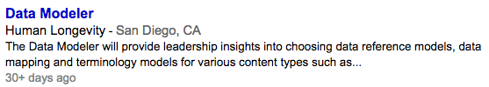
Jobs in Ontological Engineering

Slide 14
Upper Ontology
General Framework of Concepts
Reuse/inherit these generic concepts to model more specific concepts
Similar to concepts of “inheritance” in programming languages
FOL is one way of representing this knowledge

Slide 15
Example Upper Ontology
Anything
AbstractObject
GeneralizedEvents
Sets
Numbers
Numbers
…
Interval
Process
…

Slide 16
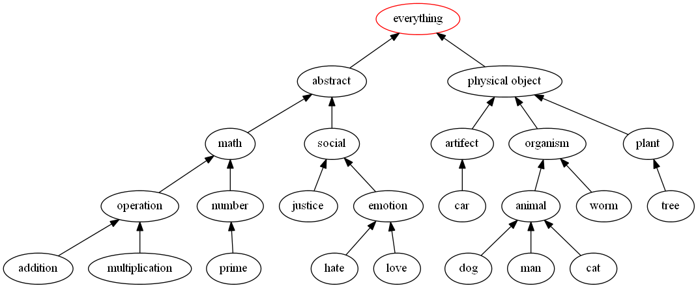
Wordnet Upper Ontology

Slide 17
Characteristics of a general purpose ontology
It should be applicable to any special purpose domain
Different area of knowledge must be unified
e.g. A robot circuit repair system needs to know about:
electrical connectivity
physical layout
time
Sentences describing time must be able to work with sentences describing circuit design

Slide 18
Real World Ontologies
“Every Ontology is a treaty – a social agreement- among people with some common motive for sharing”
Team of Trained Ontologists:
Cyc (Lenat and Guha 1990)
Importing knowledge from existing databases
DBPedia (Bizer et. al. 2007)
Parsing documents and Information Extraction
TextRuner (Banki and Etzioni 2008)
Crowdsourced Commonsense Extraction
OpenMind (Singh et. al 2002, Chlovsky and Gil 2005)

Slide 19
Real World Ontologies
Cyc (Lenat and Guha 1990)
Decades worth of commonsense knowledge that is hand coded by humans
“An AI with 30 Years’ Worth of Knowledge Finally Goes to Work”
“Cyc has been given many thousands of facts, including lots of information that you wouldn’t find in an encyclopedia because it seems self-evident. It knows, for example, that that Sir Isaac Newton is a famous historical figure who is no longer alive. But more important, Cyc also understands that if you let go of an apple it will fall to the ground; that an apple is not bigger than a person; and that a person cannot throw an apple into space.”
Notes:
pro – we have a lot of knowledege that is usually not coded in text
con – it takes 30 years or more to go into production, finding funding is hard

Slide 20
Real World Ontologies
DBPedia (Bizer et. al. 2007)
DBpedia is a crowd-sourced community effort to extract structured information from Wikipedia and make this information available on the Web. DBpedia allows you to ask sophisticated queries against Wikipedia, and to link the different data sets on the Web to Wikipedia data. They hope that this work will make it easier for the huge amount of information in Wikipedia to be used in some new interesting ways. Furthermore, it might inspire new mechanisms for navigating, linking, and improving the encyclopedia itself.

Slide 21
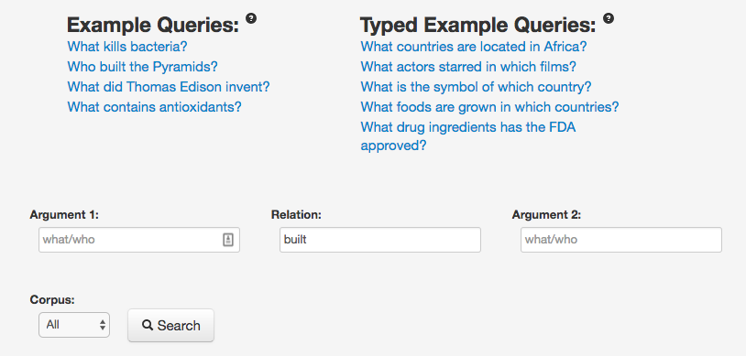
Real World Ontologies
TextRuner (Banko and Etzioni 2008)
http://openie.allenai.org/
Notes:
Etzioni –Used to be professor at UW, now CEO of AI2

Slide 22

Real World Ontologies
OpenMind (Singh et. al 2002, Chklovsky and Gil 2005)
Amateurs and volunteers proposed information about the world.
Cons – Tay.ai – The Microsoft bot that learned what people told it
It became controversial very quickly, based on what people were teaching it

Slide 23
Creating Ontologies

Slide 24
Categories and Objects
Why is categorization important?
It helps with faster retrieval, human information understanding, disambiguation, amongst other things
Categories organize knowledgebases through inheritence
e.g. cars are a vehicle, Camry is a car
Camry inherits properties of vehicle
Subclass relations organize categories into a taxonomy

Slide 25
is-a relation
All horses are animals
Ax horse(x) → animal(x)
isa(horse, animal)
NaOH is a chemical
Ax naoh(x) → chemical(x)
isa(naoh, chemical)

Slide 26
Categories and Objects
Disjoint Relations: Two or more categories are disjoint if they have no members in common
e.g. a player can be part of only one team at a time
Exhaustive Decomposition: All the possible ways in which a given category can be decomposed
e.g. North America -> USA, Canada, Mexico

Slide 27
Categories and Objects: PartOf
PartOf relation (or Part_of etc.) is one way of capturing the partonymic or meronymic relationship between objects

Slide 28
Part-of Relations
Types of Part-Of Relations (Girju 2002)
COMPONENT–INTEGRAL OBJECT
e.g kitchen–apartment
MEMBER–COLLECTION
e.g. tree-forest, player-team
PORTION–MASS
e.g. slice-pie
STUFF–OBJECT
e.g. alcohol-wine
FEATURE–ACTIVITY
e.g. paying-shopping
PLACE–AREA.
e.g. Seattle-Washington
Notes:
Goes to show that part-of relations are not simple either, and there is a lot of complex semantic handling that is required in the background to capture the true meaning of a concept

Slide 29
Properties of Part-of Relations
Part of Relations are Transitive
part_of(x,y) ^ part_of(y,z) ➔ part_of(x,z)
Part of Relations are reflexive
part_of(x,x)

Slide 30
Measurements
Scientific as well as commonsense theories have numerical information such as height, mass, weight, cost, etc.
e.g.
length(L₁) = inches(1.5) = centimeters(3.81)
centimeters(2.54 * d) = inches(d)
list_price(basketball) = dollar(19)

Slide 31
Objects: Things and Stuff
Butter and Pencils
Butter cannot be cut in half, Pencil can
The former is a mass noun and the latter is a count noun
Intrinsic Properties
These properties belong to the substance of the object, rather than the object as a whole. e.g. butter vs amount of butter
e.g. tasty(x) ^ butter(x)
(The butter is tasty)
Extrinsic Properties
Weight, shape length etc, belong to the object as a whole. These properties do not remain after the object has been subdivided
e.g. size_of(x, small) ^ stick_of(x, y) ^ butter(y)
(the small stick of butter)

Slide 32
Events
Continuous Events
Fluent – A condition that can change over time
Discrete Events
Time Intervals

Slide 33
Event Representation
What are the different ways of representing events?
Situation Calculus – Representing situations as predicates
Event Calculus – Representing points of time rather than situations as predicates

Slide 34
Situation Calculus
Shankar is traveling to DC from SFO
traveling(Shankar, SFO, DC)
traveler(Shankar) ^ origin(SFO) ^ destination(DC)
Limitations:
No temporal information is captured
Process is not described
How to describe the event of “traveling”

Slide 35
Event Calculus
Reification:
Process of making a concept more concrete.
Turning a predicate into an object
Shankar is traveling to DC from SFO
traveling(e1, Shankar, SFO, DC)
traveler(e1, Shankar) ^ origin(e1, SFO) ^ destination(e1, DC)
Now we can describe the journey
long(e1)
delayed(e1)

Slide 36
Event Calculus
T(f, t) | Fluent f is true for time t
Happens(e, i) | Event e happens over time interval i
Initiates(e, f, t) | Event e causes fluent f to start to hold at time t
Terminates(e, f, t) | Event e causes fluent f to start to hold at time t
Clipped(f, i) | Fluent f ceases to be true at some point during time interval i
Restored(f, i) | Fluent f becomes true sometime during time interval i

Slide 37
Events: Time Intervals
Moments
Intervals that happen in an instant
Time = 0
event(i) ^ duration(i, j) ^ seconds(j, 0)
Intervals
Have a duration
Have a start and end time

Slide 38
Date and Time
Interval(i) => Duration(i) = Time(end(i)) – Time(beginning(i))
Time(Begin(AD1900)) = Seconds(0)
Time(Begin(AD2001)) = Seconds(3187324800)
Time(Begin(AD2001)) = Seconds(3218860800)
Duration(AD2001) = Seconds(31536000)
Date(Begin(AD2001)) = Date(0, 0, 0, 1, Jan, 2001)
Date(0, 20, 21, 24, 1, 1995) = Seconds(3000000000)

Slide 39
Event Intervals
Meet(i,j) ⬄ End(i) = Begin(j)
Before(i,j) ⬄ End(i) < Begin(j)
After(j, i) ⬄ Before(i,j)
i
j
i
j

Slide 40
Event Intervals
During(i, j) ⬄ Begin(j) < Begin(i) < End(i) < End(j)
Overlap(i, j) ⬄ Begin(i) <Begin(j) < End(i) < End(j)
i
j
i
j

Slide 41
Event Intervals
Begins(i, j) ⬄ Begin(i) = Begin(j)
Finishes(i, j) ⬄ End(i) = End(j)
Equals(i, j) ⬄ Begin(i) = Begin(j) ^ End(i) = End(j)
i
j
i
j
i
j

Slide 42
Real World Application
What if we can develop a system that can cure cancer after reading millions of research papers?
XPD appears to be degraded in wild-type embryos
between
prophase and metaphase of the first cell division
after
the onset of zygotic gene expression,
which coincides with
a redistribution of CDK7 from the cytoplasm to the nucleus.
A
between
B and C
after
D
which coincides with
E.
B A C
D = E

Slide 43
Time and Causality
We can capture knowledge from written language in real time using logic based axioms
1 2 3 4 5 | Causal Axioms in-in(e4,x2) & response-nn(x2) & to-in(x2,x3) → CAUSES(x3,e4) & BEFORE(x3,e4) result-vb(e0,x0) & in-in(e0,x8) →CAUSES(x0,x8) & BEFORE(x0,x8) lead-vb(e1,x1) & to-in(e1,x3) → CAUSES(x1,x3) & BEFORE(x1,x3) in-in(e4,x2) & order(x2) & to-in(x2,x3) → CAUSES(e4,x3) & BEFORE(e4,x3) upon(e14,x15) → CAUSES(x15,e14) & BEFORE(x15,e14)
6 7 8 | Time based Axioms start-vb’(e1,x1,e2) → BEGINS(x1,e2) progression-nn(x1) & into-in(x1,x2) → BEGINS(x1,x2) onset-nn(x1) & of-in(x1,x2) → BEGINS(x1,x2)

Slide 44
Inference in FOL
exposure-nn(x2) & …& result-vb’(e0,x2) & in-in(e0,x8) & …& activation-nn(x8) & …
BEFORE(x2,x8) & CAUSES(x2,x8)
Final Logical Form: exposure-nn(x2) & …& BEFORE(x2,x8) & CAUSES(x2,x8) & …& activation-nn(x8) & …

Slide 45
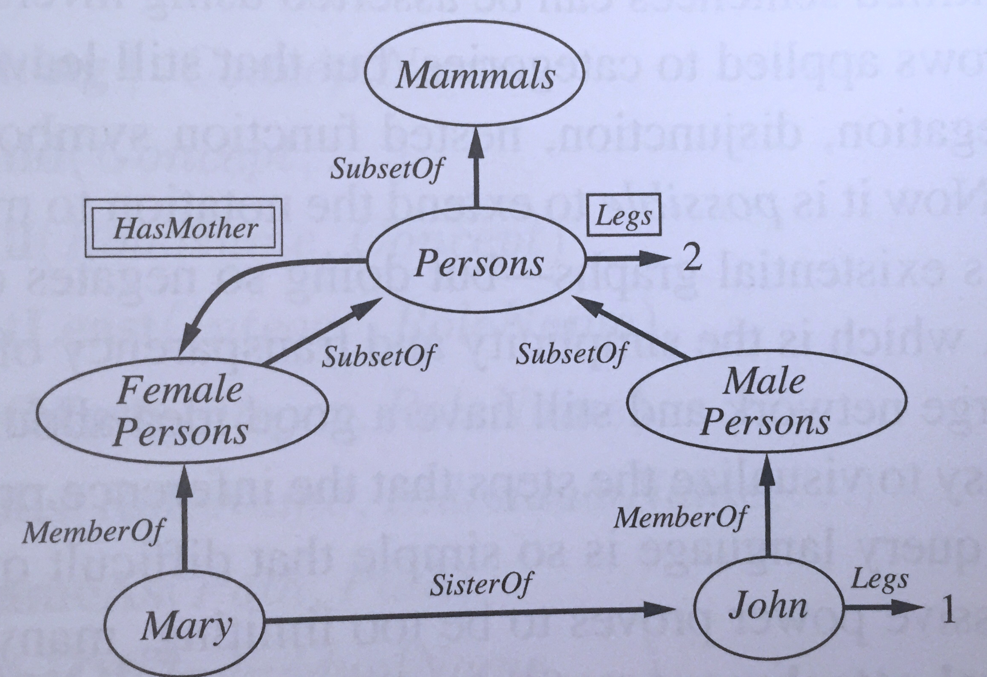
Visualizing Ontologies
Tools you can use:
graphviz

Slide 46
Limitation of FOL
One drawback of FOL is that it is not able to capture uncertainty or exceptions to the norm
e.g. most tomatoes are red, but not all are red
More in the next section of this class (Statistics and Uncertainty)

